Slide 1
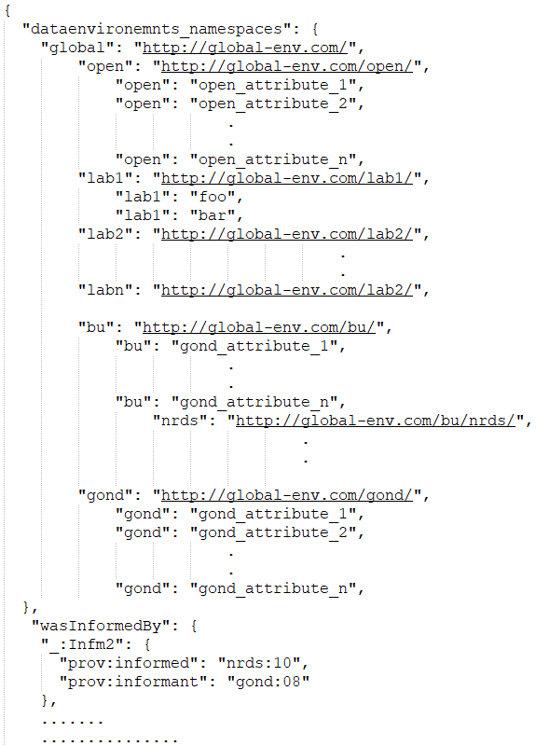
University of Barsetshire
http://global-env.com/bu/
ag
en
ac
en
GOND
http://global-env.com/gond/
ag
en
Labs
ac
http://global-env.com/bu/nrds/
en
http://global-env.com/bu/nrds/
http://global-env.com/bu/labn/
ag
en
ag
en
ag
ac
en
ac
en
NRDS
ac
en
http://global-env.com/bu/nrds/
en
ag
en
ac
en
Open Environment
http://global-env.com/open/
ag
en
ac
en

Slide 2
actedOnBehalfOf
wasGeneratedBy
actedOnBehalfOf
wasAssociatedWith
wasAssociatedWith
wasAssociatedWith
wasAssociatedWith
used
used
used
used
wasInformedBy
wasGeneratedBy
wasGeneratedBy
wasGeneratedBy
wasGeneratedBy
used
used
used
used
bundle-2a:NRDS
bundle-1:GOND
bundle-2:UniversityBarsetshire
wasInformedBy
wasInformedBy
wasAssociatedWith
wasAssociatedWith
wasGeneratedBy
wasGeneratedBy
used
used
wasGeneratedBy
wasGeneratedBy
used
used
bundle-3:Lab1
bundle-3a:Lab2
wasInformedBy
wasInformedBy
wasInformedBy
wasGeneratedBy
wasGeneratedBy
wasGeneratedBy
used
used
used
bundle-4:open
wasGeneratedBy
bundle-N:GlobalEnvironment

Slide 3
Global Environment
2
University of Barsetshire
3_{n}
2_{a}
Research Lab
4
Open
Environment
National Research Data Service (NRDS)
t5
t4
3_{n+1}
Research Lab
t3
t6
t7
1
t1
t1
t2
Government Office for National Data (GOND)
External Data Flow
Internal Data Flow
Contract

Slide 5
http://global-env/
University of Barsetshire
GOND
http://global-env.com/ub/
http://global-env.com/gond/
ag
en
A
ag
en
A
ac
en
Labs
ac
en
http://global-env.com/lab1/
NRDS
http://global-env.com/lab2/
http://global-env.com/nrds/
http://global-env.com/lab3/
http://global-env.com/labn/
http://global-env.com/gond/ag/
ag
en
ag
en
A
A
ac
ac
en
en
Open Environment
http://global-env.com/op/
http://global-env.com/op/ → http://global-env.com/gond/
ag
en
A
ac
en
http://global-env.com/op/A/

